Slide 1
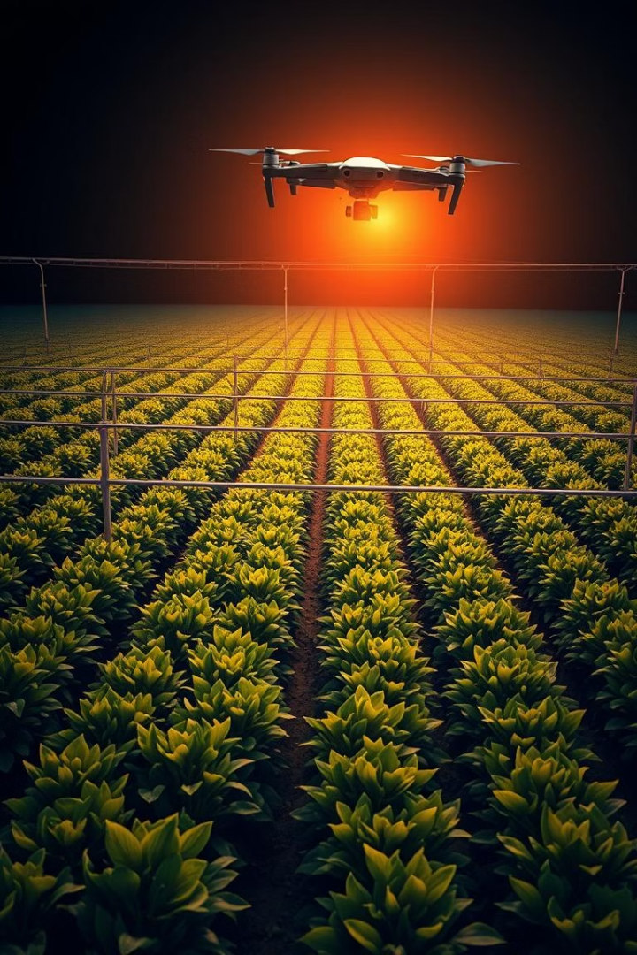
Smart Irrigation with Drones: Precision Agriculture for a Sustainable Future
Discover how intelligent irrigation systems, powered by drone technology, are revolutionizing agriculture. This presentation explores the problem of inefficient water use, the solution offered by smart irrigation, and the key benefits of adopting this innovative approach.

Slide 2
Limitations of Traditional Irrigation
Common Irrigation Methods
Inefficiencies
Environmental Impact
Flood irrigation
Overwatering
Soil erosion
Sprinkler irrigation
Uneven distribution
Groundwater depletion
Drip irrigation
Evaporation
Fertilizer runoff
Traditional irrigation methods often lead to significant water wastage and environmental damage. The FAO estimates that these methods can waste up to 50% of the water applied.

Slide 3
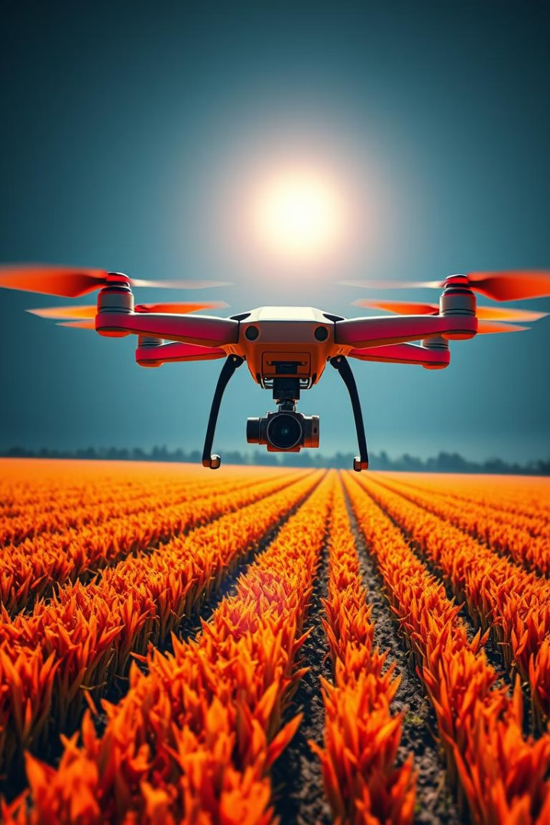
The Smart Irrigation System: An Overview
Drones
Sensors
Data Analytics
Controllers
The smart irrigation system comprises drones, sensors, a data analytics platform, and automated irrigation controllers. Drones gather real-time data on soil moisture, plant health, and environmental conditions using multispectral and thermal cameras.

Slide 4

How Drone Technology Works
1
Multispectral Imaging
2
Thermal Imaging
Identifies plant stress, nutrient deficiencies, and disease.
Detects water stress by measuring leaf temperature.
3
LiDAR
Creates 3D terrain maps for accurate water distribution.
Drones like the DJI Matrice 300 RTK, equipped with a P4 Multispectral camera, provide highly accurate data (within 2cm) for effective water distribution planning.

Slide 5
Data Analytics Platform: Actionable Insights
1
Data Processing
2
Machine Learning
3
Custom Plans
The cloud-based platform analyzes drone-captured data using machine learning algorithms to predict water requirements. It generates customized irrigation plans based on real-time conditions and integrates with existing systems.

Slide 6



Automated Irrigation Controllers: Precision
Smart Valves
2
Precisely controls water flow to individual zones.
Wireless Communication
Receives irrigation schedules from the analytics platform.
1
Feedback Loops
3
Monitors soil moisture and adjusts irrigation in real-time.
Smart valves, controlled by wireless communication (e.g., LoRaWAN), precisely deliver water to individual zones. They monitor soil moisture and adjust irrigation in real-time.

Slide 7




Key Benefits of Smart Irrigation
Sustainability
1
Minimizes waste
Cost Savings
2
Lowers costs
Crop Yields
3
Increases yields
Water Conservation
4
Reduces water use
Smart irrigation reduces water usage by up to 40% and increases yields by 10-20%. Lowers operational costs and minimizes water wastage, and the system can pay for itself in 2-3 growing seasons.

Slide 8
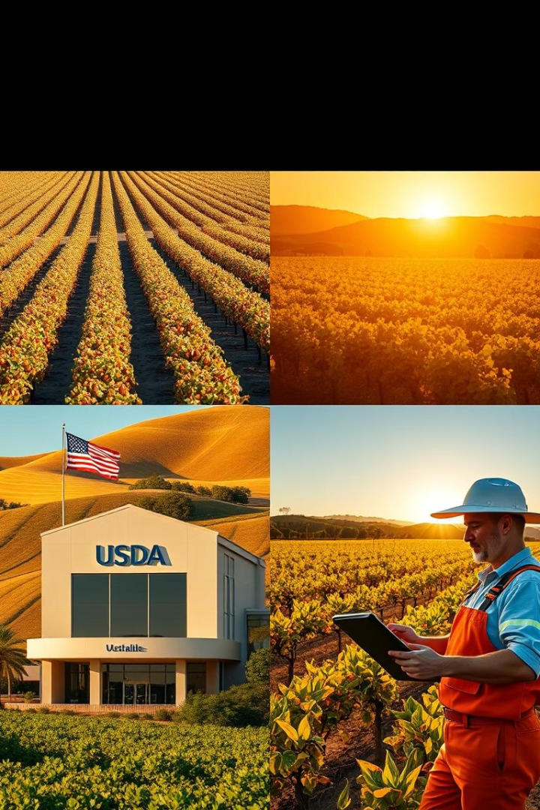
Real-World Applications: Case Studies
California Almond Farms
30% water reduction
Australian Vineyards
15% yield increase
USDA Initiatives
Government subsidies
California almond farms saved 1.2 million gallons of water per acre. Government subsidies support the adoption of smart irrigation technologies.

Slide 9
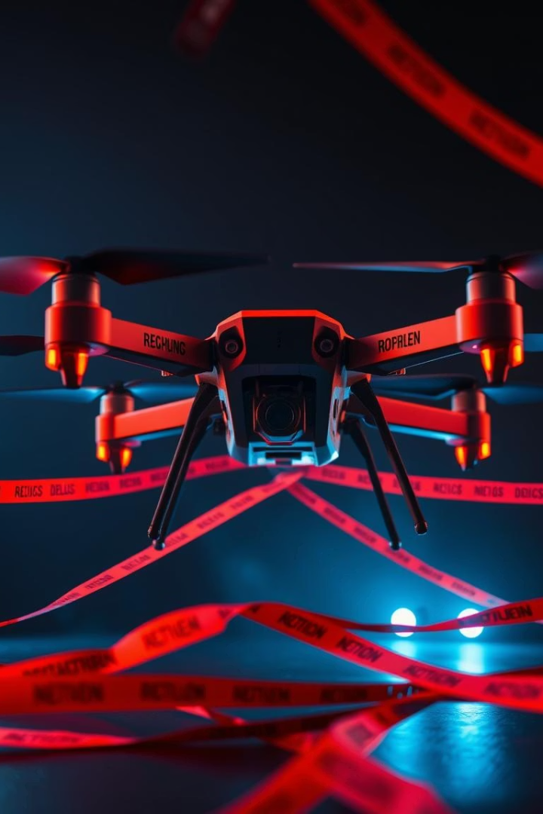



Challenges and Opportunities
Initial Costs
Investment for hardware
Data Security
Data privacy and prevention
Regulatory Hurdles
FAA and data policies
Addressing these challenges will unlock significant opportunities as hardware costs decrease, software sophistication increases, and supportive government policies emerge.

Slide 10
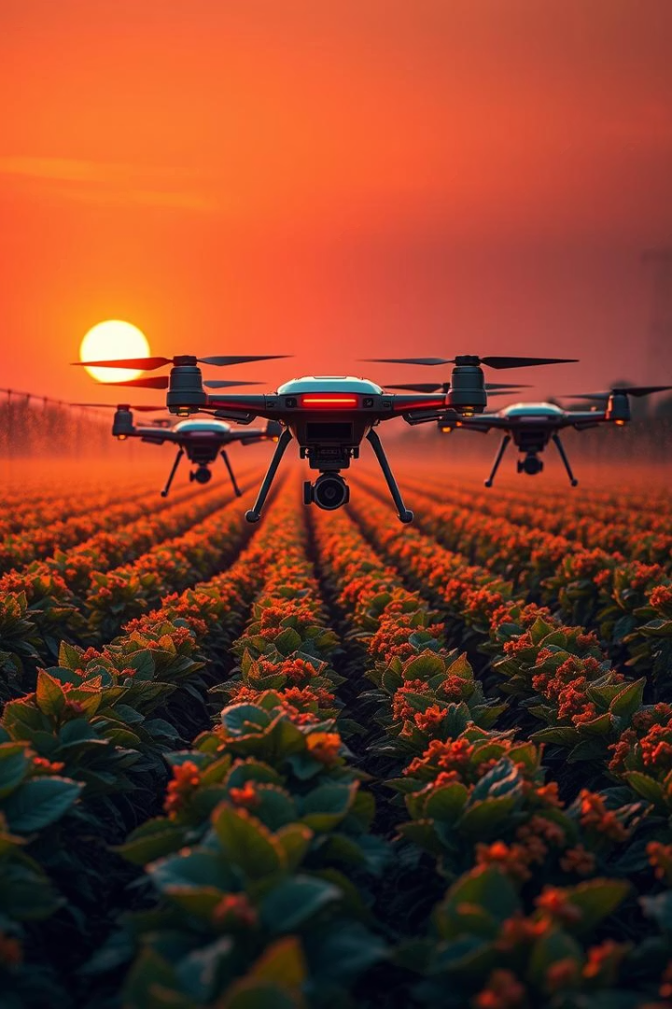
The Future of Smart Irrigation
12B
Market by 2027 (USD)
AI-powered irrigation and IoT sensors will enable comprehensive monitoring and proactive water management. Autonomous drones will fully automate data collection and irrigation control. The market is expected to reach $12B by 2027.

